Slide 1
Lamoille County CSP Outreach: Looking ahead to FY2023
Environmental Quality Incentives Program (EQIP)
01
Conservation Stewardship Program (CSP)
02
Agricultural Management Assessment Program (AMA)
03
Regional Conservation Partnership Program (RCPP)
04
EQIP
Land Management and Rental
Easements
Agricultural Conservation Easement Program (ACEP)
05

Slide 2
Life Cycle of an Application: CSP
Conservation Stewardship Program (CSP)
CSP provides two possible types of payments through 5-year contracts:
Annual payments for installing new conservation activities and maintaining existing practices
Supplemental payments for meeting specific resources thresholds at the time of your application and assessment.
NRCS may provide a minimum annual payment of $1,500 in any year the total contract amount is below a rate NRCS determines equitable based upon the effort required by a participant to meet contract requirements.
Stewardship Threshold Eligibility:
Met at least 2 Priority Resource Concerns when they apply.
Must also agree to Meet or Exceed the stewardship threshold for at least one additional priority resource concern by the end of the contract.

Slide 3
Eligibility: Which 2 resources are you managing well?
Met at least 2 priority Resource Concerns when applying.
SWAPAE+H
Soil
Water
Air
Plant
Animal
Economic
Human

Slide 4
Eligibility: Which resource will you improve?
Must agree to Meet or Exceed threshold for at least one additional priority resource concern by the end of the contract.
SWAPAE+H
Soil
Water
Air
Plant
Animal
Economic
Human

Slide 5
Life Cycle of an Application: CSP
Conservation planners will plan site visits to survey land and review resource concerns.
Some projects require multiple site visits to ensure adequate planning.
Planners will assess applications based on the following to receive a ranking score:
Resource Concerns
Resource Inventory
Existing Practices/Historical Practices
Planned Practices
State Generated Ranking Questions
Conservation Ranking and Assessment Period
CSP: 03/17/202X

Slide 6
Payments and Certifications
CSP payments are made annually, and include Land Use Payments, Resource Concerns Met at time of Application Payment and any completed enhancements/practices completed that year.
Participants are responsible for paying income tax on any NRCS payments. By law, you must report any payments you receive from NRCS as taxable income when filing your annual income tax return. (Also applies to Payment Assignments)
You may need to consider how this will impact your tax returns. Payments are usually spaced out over multiple tax years.

Slide 7
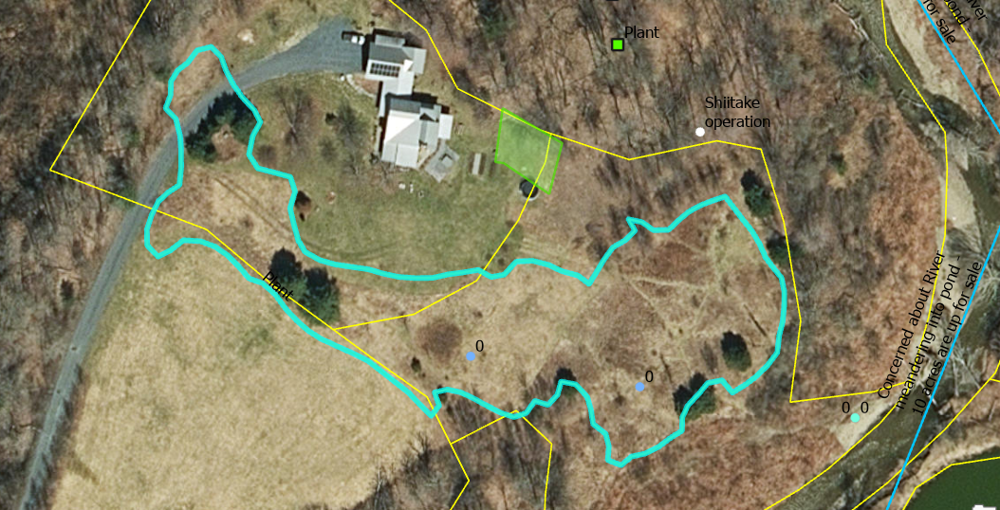

Slide 8
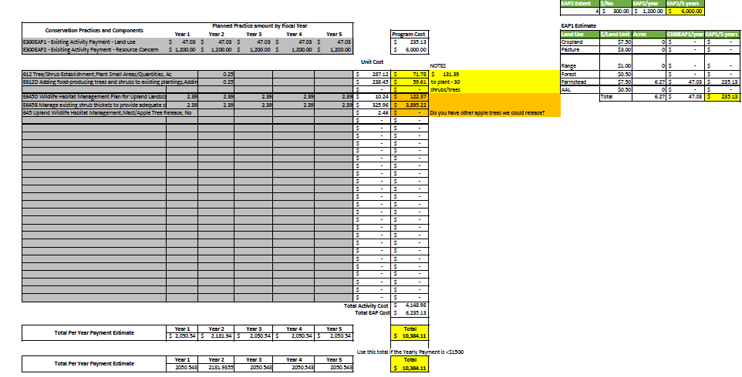

Slide 9
Field Office Contact Information:
Morrisville Field Office:
109 Vernon Street,; Suite 332
Brattleboro, VT, 05301
(802) 689-3037
Name: | Position |  | Email
Sarah Larose | District Conservationist (Grand Isle, Franklin, Lamoille) |  | Sarah.larose@usda.gov
Nancy Allen | Soil Conservationist (Morrisville) |  | Nancy.allen@usda.gov
Sean Pease | Soil Conservationist (Morrisville) |  | Sean.pease@usda.gov

